Slide 1
Rocket Motors

Slide 2
CONTENTS OF THIS TEMPLATE
You can delete this slide when you’re done editing the presentation
Fonts | To view this template correctly in PowerPoint, download and install the fonts we used
Used and alternative resources | An assortment of graphic resources that are suitable for use in this presentation
Thanks slide | You must keep it so that proper credits for our design are given
Colors | All the colors used in this presentation
Icons and infographic resources | These can be used in the template, and their size and color can be edited
Editable presentation theme | You can edit the master slides easily. For more info, click here
For more info: SLIDESGO | BLOG | FAQS
You can visit our sister projects: FREEPIK | FLATICON | STORYSET | WEPIK | VIDEVO

Slide 3
TABLE OF CONTENTS
01
02
03
OBSERVATORY
TELESCOPES
SATELLITES
You could describe the topic of the section here
You could describe the topic of the section here
You could describe the topic of the section here

Slide 4
Rocket Propulsion
Solid Fueled Rockets
Liquid Fueled Rockets
Hybrid Rockets

Slide 5
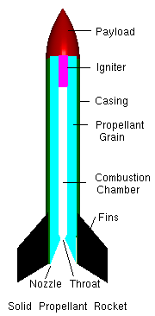
Solid Propulsion

Slide 6
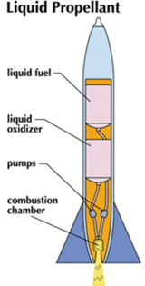
Liquid Propulsion

Slide 7
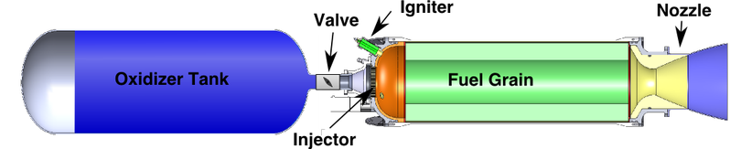
Hybrid Propulsion

Slide 8
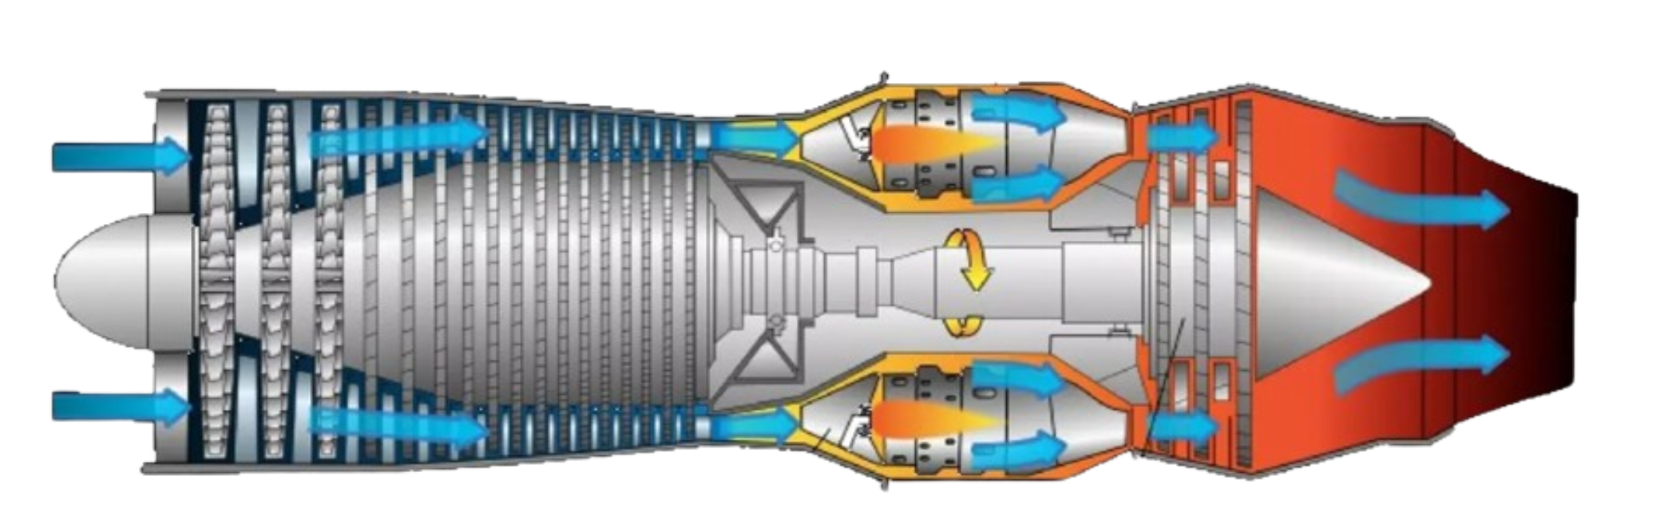
Airplane Motors

Slide 9
OUR OPTICAL OBSERVATORIES
A
B
MERCURY
VENUS
Mercury is the closest planet and the smallest one in the Solar System
Venus has a beautiful name and is the second planet from the Sun

Slide 10
COSMIC RADIO WAVE EMITTERS
MARS
JUPITER
MERCURY
Despite being red, Mars is actually a very cold place
Jupiter is a gas giant and the biggest in the Solar System
It’s the closest planet to the Sun and the smallest one

Slide 11
OBSERVE EARTH SATELLITES
VENUS
MERCURY
Venus is the second planet from the Sun
Mercury is the closest planet to the Sun
MARS
JUPITER
Despite being red, Mars is a cold place
Jupiter is the biggest planet in the Solar System

Slide 12
STUDY CELESTIAL SOURCES
MERCURY
JUPITER
Mercury is the closest planet to the Sun
Jupiter is the biggest planet of them all
VENUS
SATURN
Venus is the second planet from the Sun
Saturn is composed mostly of hydrogen and helium
NEPTUNE
MARS
Neptune is the farthest planet from the Sun
Despite being red, Mars is actually a cold place

Slide 13
AWESOME WORDS

Slide 14
—SOMEONE FAMOUS
“This is a quote. Words full of wisdom that someone important said and can make the reader get inspired.”

Slide 15
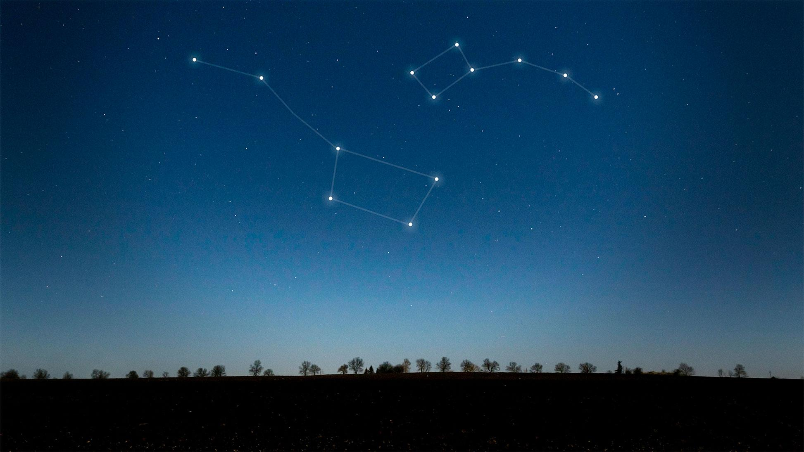
A PICTURE IS WORTH A THOUSANDS WORDS

Slide 16
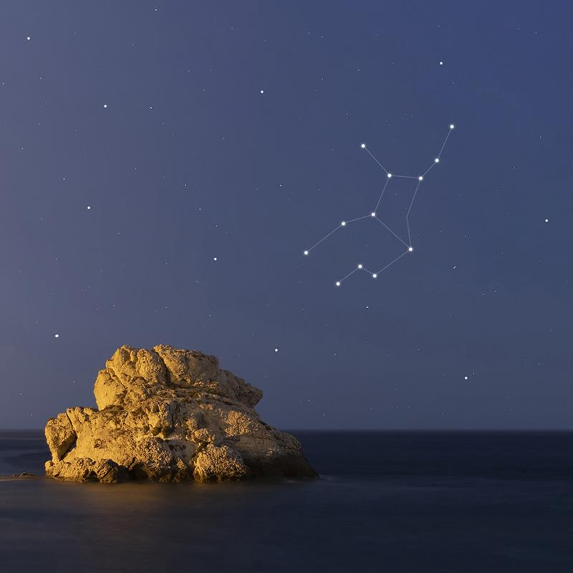
A PICTURE REINFORCES THE CONCEPT
Images reveal large amounts of data, so remember: use an image instead of a long text. Your audience will appreciate that

Slide 17
489,300.00
Big numbers catch your audience’s attention

Slide 18
24.000
33.300
38.600
Jupiter is a gas giant and the biggest planet
Saturn is a gas giant and has several rings
Neptune is the farthest planet from the Sun

Slide 19
02
OUR TELESCOPES
You could enter a subtitle here if you need it

Slide 20
THE OPTICAL TELESCOPE
40%
80%
MERCURY
VENUS
It’s the closest planet to the Sun and the smallest one
Venus has a beautiful name and is the second planet

Slide 21
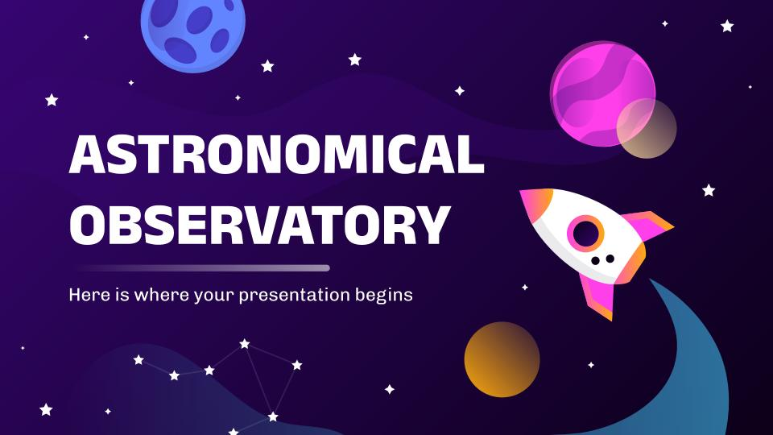
TELESCOPE SOFTWARE
You can replace the image on the screen with your own work. Just right-click on it and select “Replace image”

Slide 22
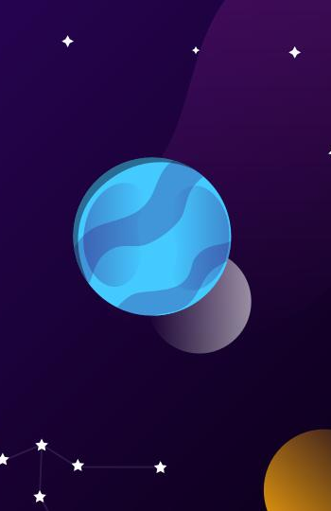
ASTRONOMIC WEBSITE
You can replace the image on the screen with your own work. Just right-click on it and select “Replace image”

Slide 23
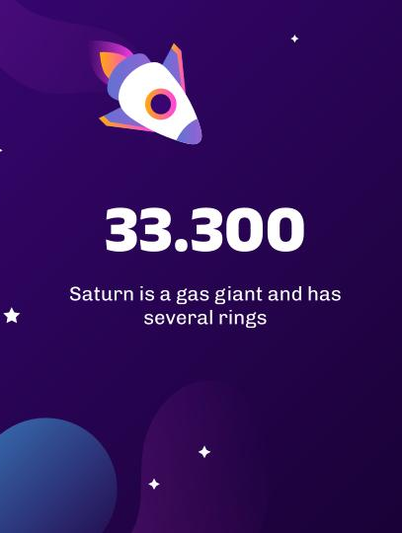
TABLET APP ABOUT STARS
You can replace the image on the screen with your own work. Just right-click on it and select “Replace image”

Slide 24
TELESCOPE MAP
JUPITER
Jupiter is a gas giant and the biggest planet
VENUS
Venus is the second planet from the Sun
NEPTUNE
Neptune is the farthest planet from the Sun

Slide 25
HISTORY OF OBSERVATION
1609
1789
1930
TODAY!
VENUS
MARS
MERCURY
NEPTUNE
Venus has a beautiful name
Mars is a very cold place
It’s the closest from the Sun
It’s the farthest from the Sun

Slide 26
OBSERVED CELESTIAL OBJECTS
1ST
3RD
2ND
4TH
MERCURY
JUPITER
Mercury is the closest planet
Jupiter is a gas giant planet
MARS
NEPTUNE
Mars is actually a cold place
Neptune is an ice giant planet

Slide 27
TYPES OF OBJECTS
EARTH | Earth is the planet with life | Earth is known as the blue planet | All humans live on this planet
MARS | Mars is actually a cold place | Mars is full of iron oxide dust | Mars was named after a god
MERCURY | Mercury is a very small planet | It’s the closest planet to the Sun | Mercury is the smallest of them
VENUS | Venus has high temperatures | Venus has a toxic atmosphere | Venus has a beautiful name

Slide 28
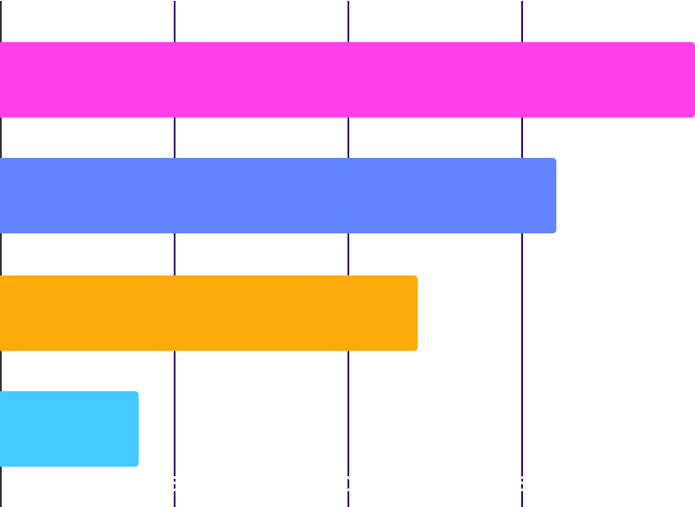
ASTRONOMICAL INSTRUMENTS
1,000
600
800
400
MERCURY
JUPITER
Mercury is the closest planet
Jupiter is a gas giant planet
MARS
NEPTUNE
Mars is actually a cold place
Neptune is an ice giant planet
Follow the link in the graph to modify its data and then paste the new one here. For more info, click here

Slide 29
03
SATELLITE OBSERVATORIES
You could enter a subtitle here if you need it

Slide 30
OUR SATELLITES
MERCURY
VENUS
Mercury is the closest planet to the Sun and the smallest one
Venus has a beautiful name and is the second planet

Slide 31
RANGE OF SATELLITES
5/25
10/25
15/25
20/25
MERCURY
SATURN
MARS
VENUS
It’s the closest planet to the Sun
Saturn is a gas giant planet
Despite being red, Mars is cold
Venus is the second planet

Slide 32
OBSERVATION PLANNING
 | January | February | April | May | June
TASK 1
TASK 2
TASK 3
TASK 4
TASK 5

Slide 33
SATELLITE POSITIONS
90°
30°
60°
0°
MERCURY
JUPITER
Mercury is the closest planet
Jupiter is a gas giant planet
MARS
NEPTUNE
Mars is actually a cold place
Neptune is an ice giant planet

Slide 34


OUR TEAM
CRISTINA SHARP
OLIVER PATH
Here you can talk a bit about this person
Here you can talk a bit about this person

Slide 35
THANKS!
Do you have any questions?
youremail@freepik.com
+91 620 421 838
yourcompany.com
Please keep this slide for attribution

Slide 36
ALTERNATIVE RESOURCES
Here’s an assortment of alternatives resources within the same style of this template
VECTORS
Gradient galaxy background I
Gradient galaxy background II

Slide 37
RESOURCES
Did you like the resources? Get them for free at our other websites.
VECTORS
Gradient space with a rocket I
Gradient space with a rocket II
Gradient space with a rocket III
Gradient galaxy background I
Gradient galaxy background II
Gradient galaxy background III
Gradient galaxy with rocket
Star background
PHOTOS
Beautiful constellations on sky
Virgo constellation on a beautiful starry night
Woman studying in the library
Man between bookshelves

